Slide 1

Software Architecture
Software Architecture, components and implementation view

Slide 2
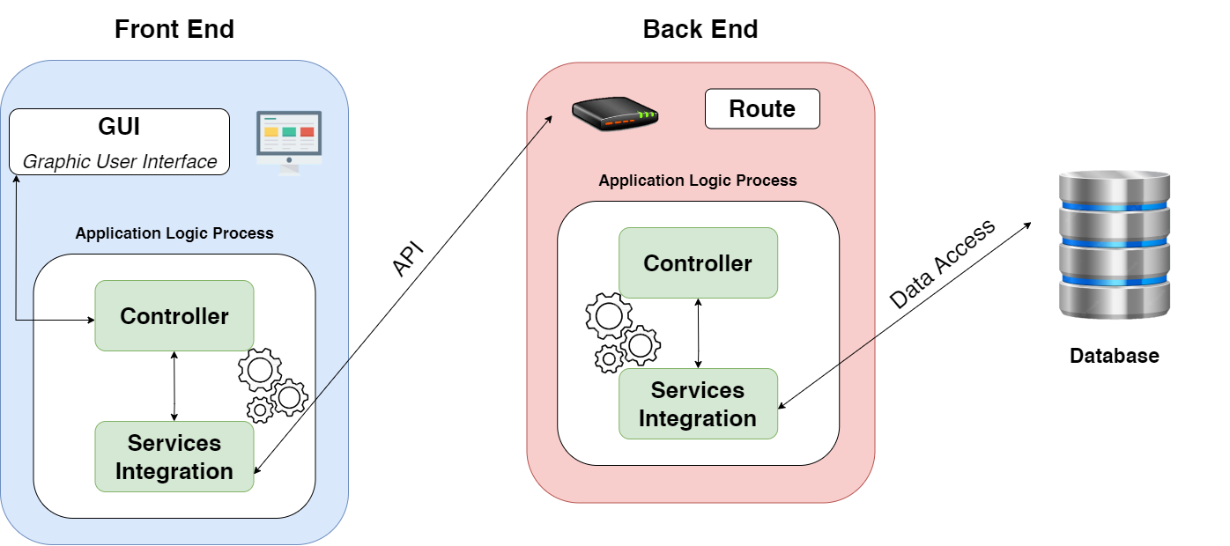
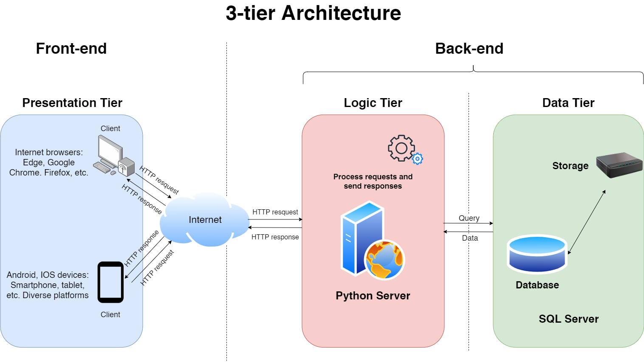
Software Architecture

Slide 3
Components
GUI components:
Authentication GUI
Post GUI
Admin GUI
User management GUI
Searching GUI
Controller components:
Authentication Controller
Post Controller
Admin Controller
User management Controller
Searching Controller
Service Integrations

Slide 4
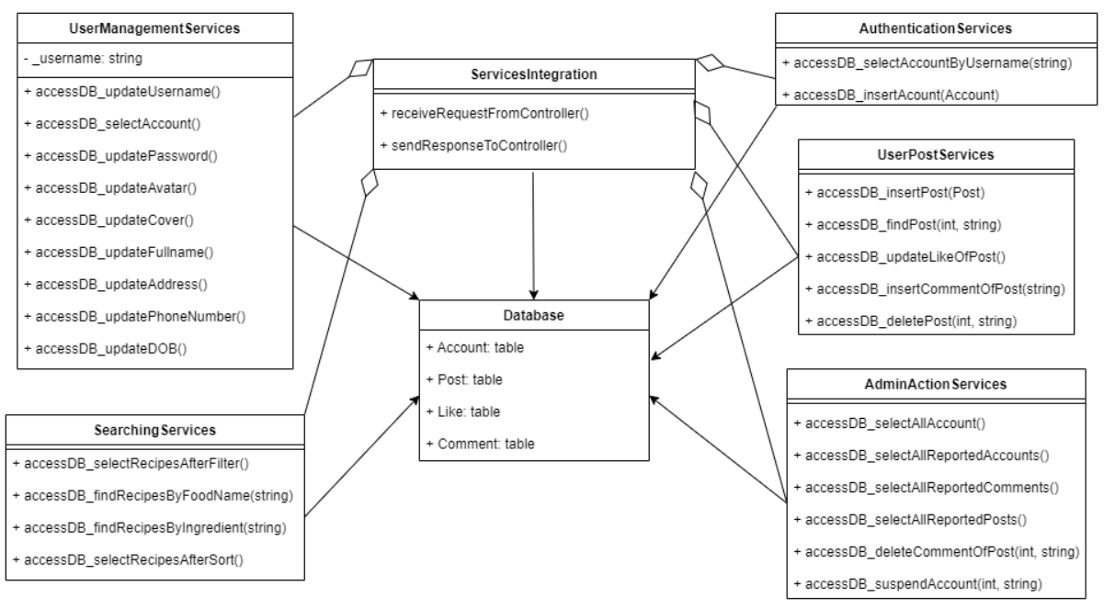
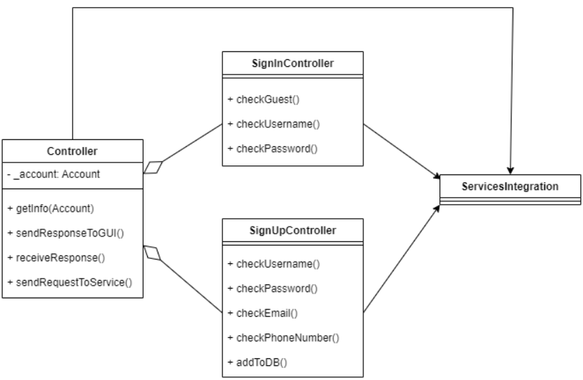
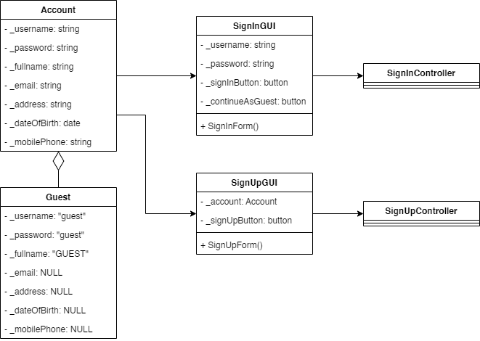
Authentication Components

Slide 5
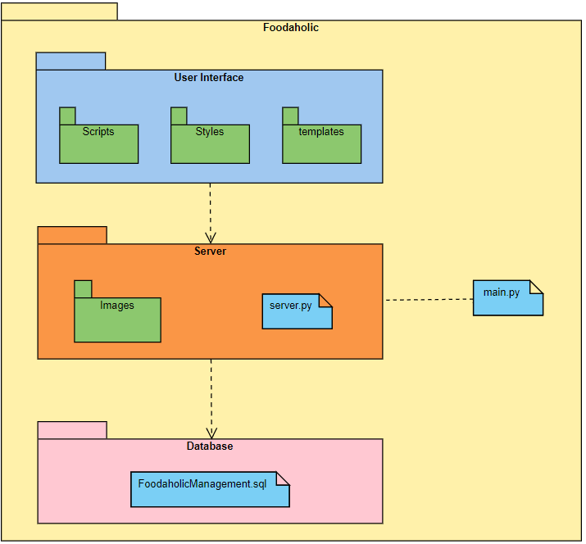
Implementation view
User Interface:
templates: save HTML files
Styles: save CSS files
Scripts: save JavaScript files
Server:
Images: save images
server.py, main.py: files to run software server
Database:
FoodaholicManagement.sql

